Slide 1
PH2X1: WPR1 Grade Brief

Slide 2
PH2X1: WPR2 Grade Brief 26 NOV 24

Slide 3
PH201 WPR-2 Grades AY 25-1
Fall 2024 - (Post-Exam Course OML Attached)
​​ | AY25-1 | AY 24-2​ | AY 24-1​ | AY 23-2​ | AY 23-1​​ | AY 22-2​​ | AY 22-1​​ | AY 21-2​​ | AY 21-1​​
Cadets​​ | 595 | 567​ | 494​ | 386​ | 485​​ | 428​​ | 507​​ | 441​​ | 449​​
Pre-Exam AVG​​ | 86.0% | 84.4 %​ | 83.1%​ | 85.27%​ | 84.37%​​ | 82.89%​​ | 81.10%​​ | 79.39%​​ | 79.94%​​
Exam AVG​​ | 79.5% (v1) | 79.0 %​ | 83.1%​ | 86.15%​ | 83.15​%​ | 83.45% (A)​​ | 83.75%​​ | 79.49%​​ | 91.58%​​
 |  |  |  |  |  | 89.55% (B)​​
 |  | 77.7 %​
 |  |  |  |  |  | 80.25% (C)​​
 |  |  |  |  |  | 81.42% (D)​​
 | 78.5% (v2) | 78.8 %​ | 74.8%​ | 84.19%​ | 87.32​%​ ​​
 |  |  |  |  |  | 79.51% (E)​​ |  | 77.00%​​ | ​​
 |  |  |  |  |  | 81.65% (F)​​
 |  | 83.6 %​
 |  |  |  |  |  | 82.35 (Total)​​
# Exam Failures​​ | 84 | 81​ | 61​ | 19​ | 52​​ | 40​​ | 48​​ | 67​​ | 5​​
Post-Exam AVG​​ | 84.1% | 83.5 %​ | 82.2%​ | 85.35%​ | 84.10%​​ | 82.70%​​ | 81.85%​​ | 79.86%​​ | 83.46%​​
# Course Failures​​ | 7 | 15​ | 10​ | 2​ | 3​​ | 14​​ | 31​​ | 27​​ | 6​​
APPROVE / DISAPPROVE
PETER H CHAPMAN, Ph.D.
COL, PR, USMA
Professor and Department of Physics and Nuclear Engineering

Slide 4
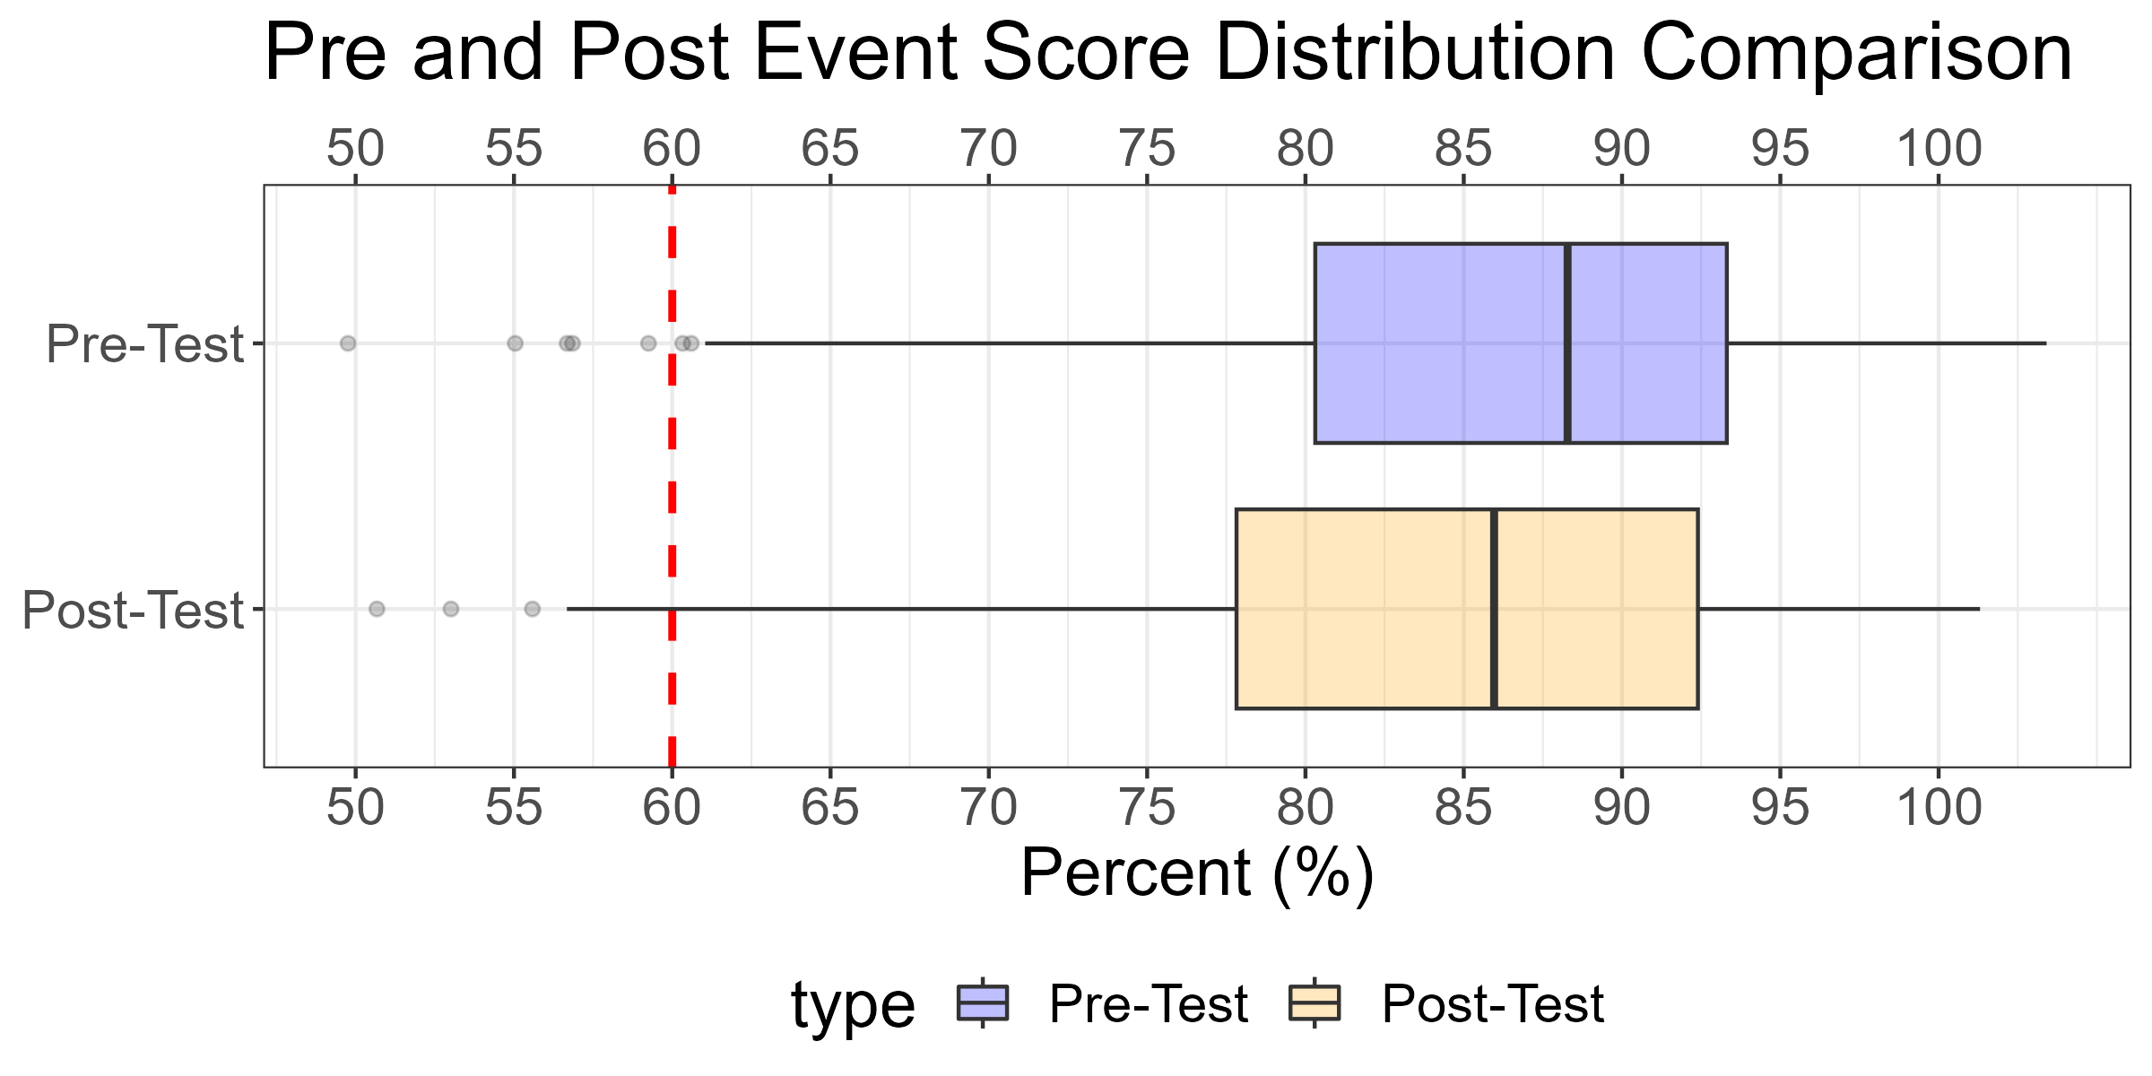
Pre/Post Course Score Comparisons
Grade | F | D | C- | C | C+ | B- | B | B+ | A- | A | A+
Pre Count | 5 | 11 | 16 | 26 | 38 | 45 | 72 | 70 | 118 | 124 | 70
Post Count | 10 | 26 | 23 | 31 | 34 | 57 | 81 | 65 | 105 | 100 | 63
Percent Change | 100% | 136% | 44% | 19% | -11% | 27% | 12% | -7% | -11% | -19% | -10%
PRE D/F's: | PRE D/F's: | PRE D/F's: | 16 (2.7%) | 16 (2.7%) | 16 (2.7%) | PRE A's: | PRE A's: | PRE A's: | 312 (52.4%) | 312 (52.4%) | 312 (52.4%)
POST D/F's: | POST D/F's: | POST D/F's: | 36 (6.1%) | 36 (6.1%) | 36 (6.1%) | POST A's: | POST A's: | POST A's: | 268 (45%) | 268 (45%) | 268 (45%)
Type | Number | Average | Median | Min | Max
Pre | 595 | 86.0 | 88.3 | 49.8 | 103.4
Post | 595 | 84.1 | 86.0 | 50.7 | 101.3

Slide 5
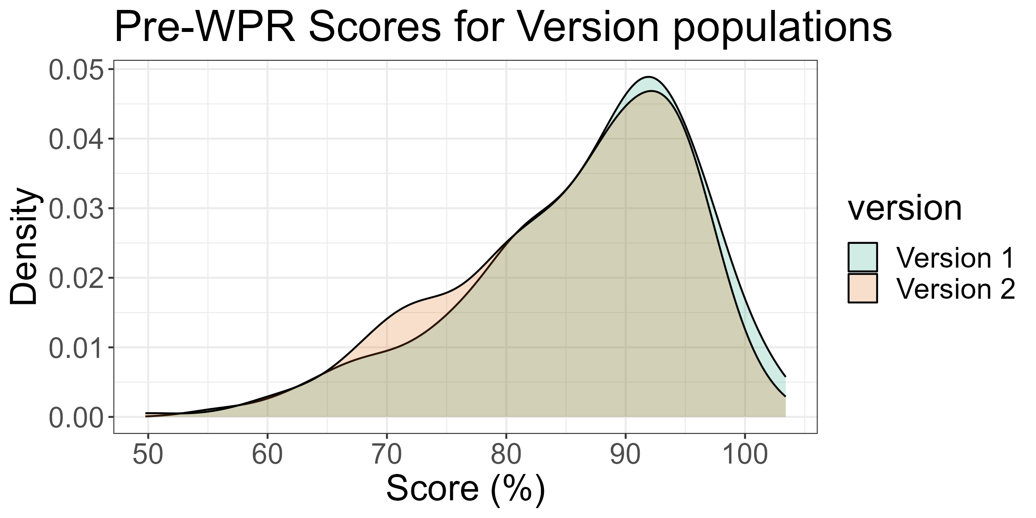
Pre Score Comparisons between versions
version | Count | Mean (%) | Median (%) | Std. Dev (%) | # D/F's | # A's
Version 1 | 318 | 86.6 | 88.7 | 9.5 | 8 (3%) | 172 (54%)
Version 2 | 277 | 85.4 | 88.1 | 9.6 | 8 (3%) | 140 (51%)
Method | result | t_value | p_value
Welch Two Sample t-test | difference in means between group Version 1 and group Version 2 | 1.527 | 1.27e-01

Slide 6
Cadets not accounted for in this brief
ID | Instructor | Section | Name | Course.ID | Assignment.ID
7924 | MAJ Taylor Bruff | 1 | Garcia, Manuel | 7515 | 162936
7947 | MAJ Taylor Bruff | 1 | Harris, Oliver | 7515 | 162936
8754 | LTC Jacob Capps | 2 | Yousefzadeh, Christian | 7516 | 155354
8104 | MAJ Taylor Bruff | 1 | Lyons, Gage | 7515 | 162936
3733 | LTC Jacob Capps | 2 | Mc Cann, Kota | 7521 | 155480
8674 | CPT Erin Norton & Dr Michael Pfenning | 8 | Rhodes, Owen | 7522 | 155425
8520 | MAJ David Simeroth | 5 | Curry, Ryan | 7524 | 155230
8346 | MAJ David Simeroth | 5 | Slivka, Bethany | 7524 | 155230
8919 | Dr Steven Vitale | 9 | McDermott, Benjamin | 7526 | 155381
8842 | Dr Steven Vitale | 9 | Vilfan, Rok | 7526 | 155381
8507 | MAJ William Schmidt | 4 | Choldin, David | 7528 | 155428
7889 | MAJ David Pert | 6 | Fradelizio, Frank | 7529 | 155385
8944 | MAJ David Pert | 6 | Williams, Christopher | 7529 | 155385
8129 | CPT Erin Norton & Dr Kraig Sheetz | 12 | Matlach, Amber | 7530 | 155610
7857 | CPT Theodore Thomas | 10 | Coats, Natas | 7531 | 155313
7699 | CPT Kevin Filip | 3 | Abalos, Leilani | 7517 | 155514
8540 | CPT Kevin Filip | 3 | Enman, Jake | 7517 | 155514
7818 | CPT Kevin Filip | 3 | Creedican, Grant | 7517 | 155514
7794 | MAJ David Simeroth | 5 | Chandler, Mary | 7533 | 155264
7956 | MAJ David Simeroth | 5 | Haney, William | 7533 | 155264
8001 | MAJ David Pert | 6 | Ingle, Brandon | 7534 | 155345
8622 | MAJ David Pert | 6 | Miller, Henry | 7534 | 155345
8230 | MAJ David Pert | 6 | Painter, John | 7534 | 155345
17871 | MAJ David Pert | 6 | Reilly, Samuel | 7534 | 155345
8405 | CPT Charles Starke | 7 | Storch, Rebecca | 7535 | 155546
17370 | CPT Richard Calvin | 1 | McKane, Angelina | 8341 | 166427
8132 | COL David Phillips & MAJ William Schmidt | 4 | Matthews, Iris | 7552 | 155386
8643 | Dr Steven Vitale | 9 | Nicholson, Thomas | 7556 | 155587
8685 | CPT Richard Calvin | 1 | Rothrock, Mercedes | 8341 | 166427
3991 | LTC Brian Holloway & Dr Michael Pfenning | 11 | Benson, Mairead | 7757 | 155366
7906 | LTC Brian Holloway & Dr Michael Pfenning | 11 | Eremita, Nicholas | 7757 | 155366

Slide 7
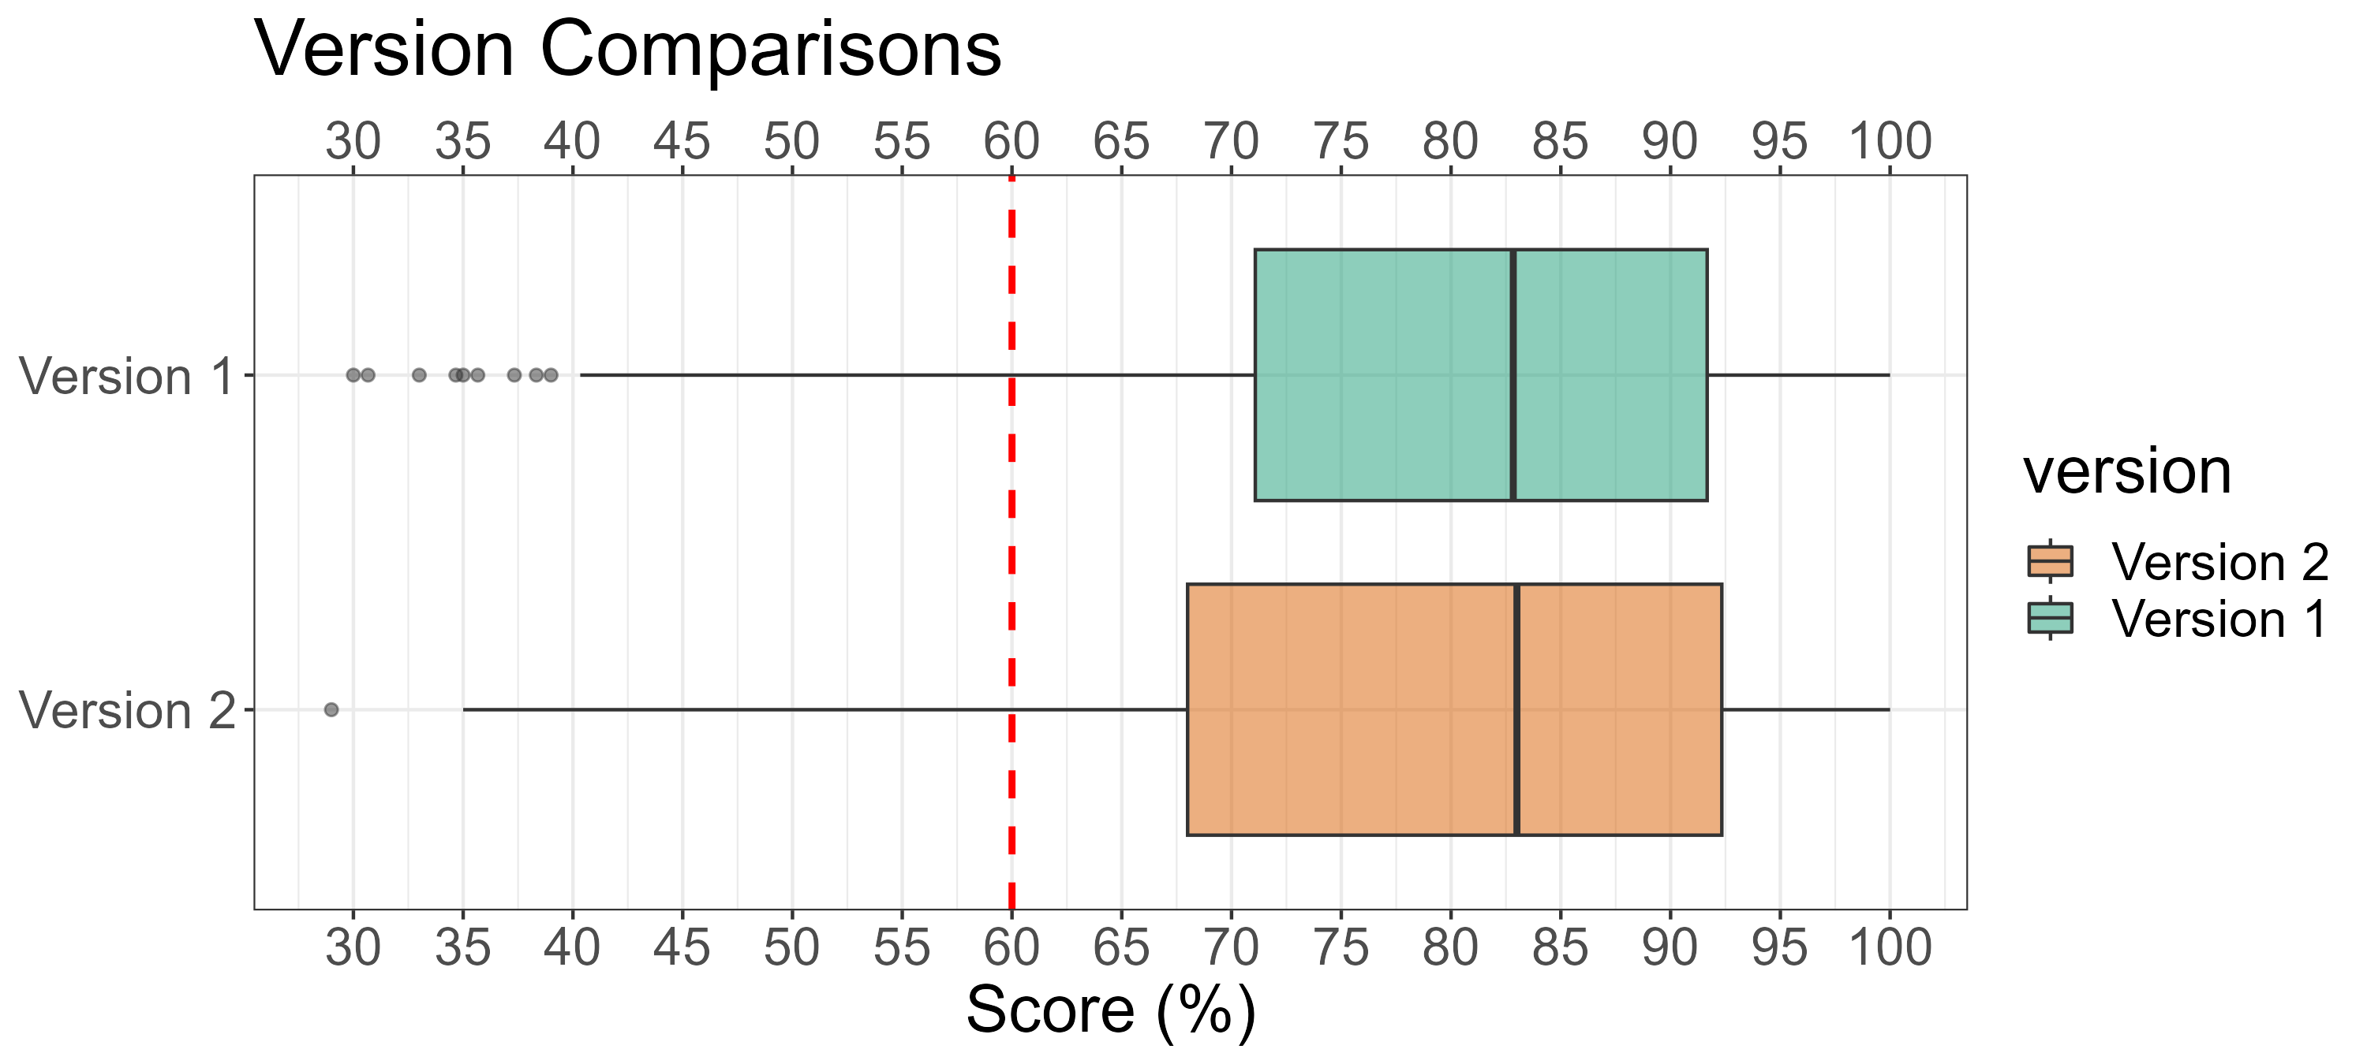
WPR 2 Version Comparisons
version | Count | Mean (%) | Median (%) | Std. Dev (%) | Min (%) | Max (%) | # D/F's | # A's
Version 1 | 318 | 79.5 | 82.8 | 15.8 | 30.0 | 100.0 | 50 (16%) | 126 (40%)
Version 2 | 277 | 78.5 | 83.0 | 16.8 | 29.0 | 100.0 | 55 (20%) | 115 (42%)

Slide 8
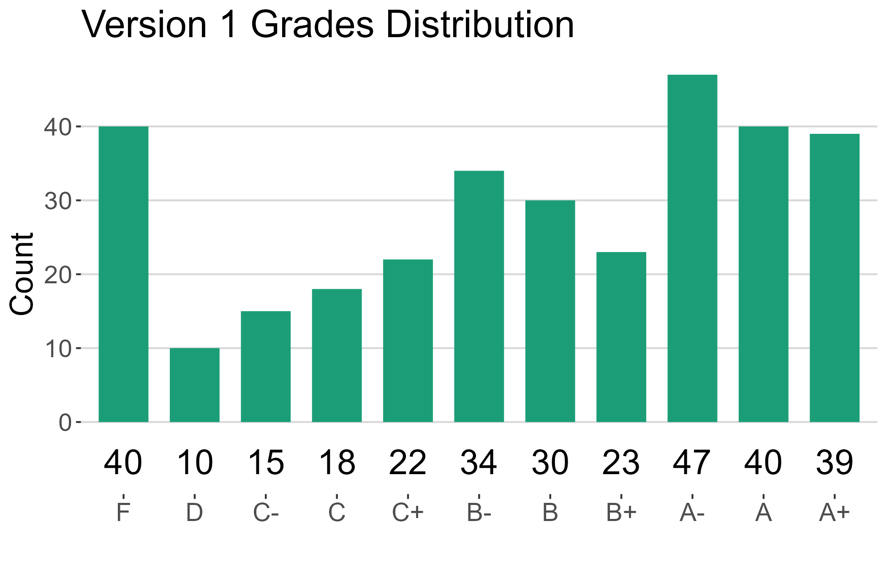
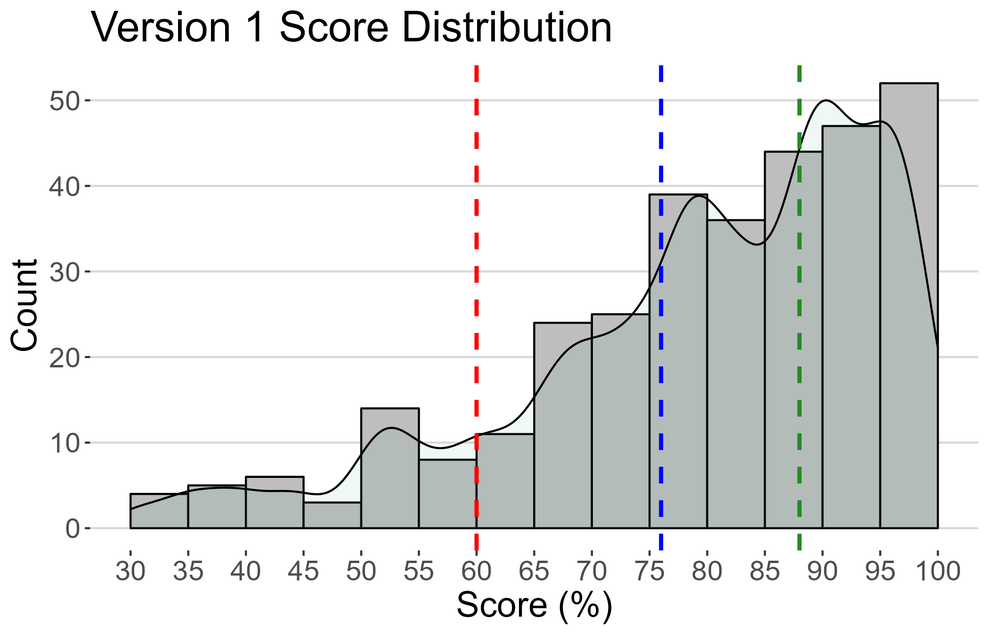
Version 1 Summary
version | Count | Mean (%) | Median (%) | Std. Dev (%) | Min (%) | Max (%) | # D/F's | # A's
Version 1 | 318 | 79.5 | 82.8 | 15.8 | 30.0 | 100.0 | 50 (16%) | 126 (40%)

Slide 9
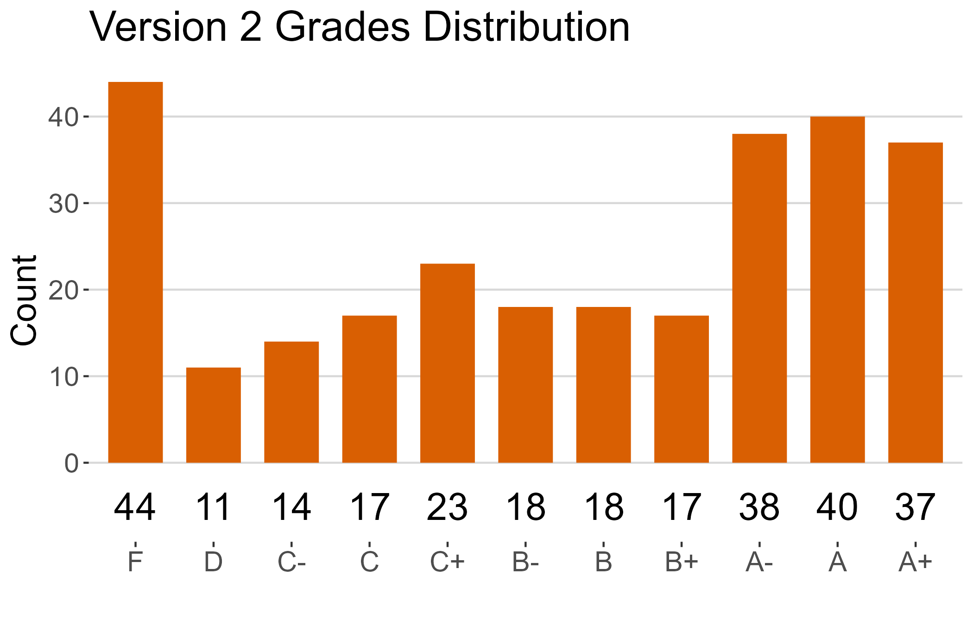
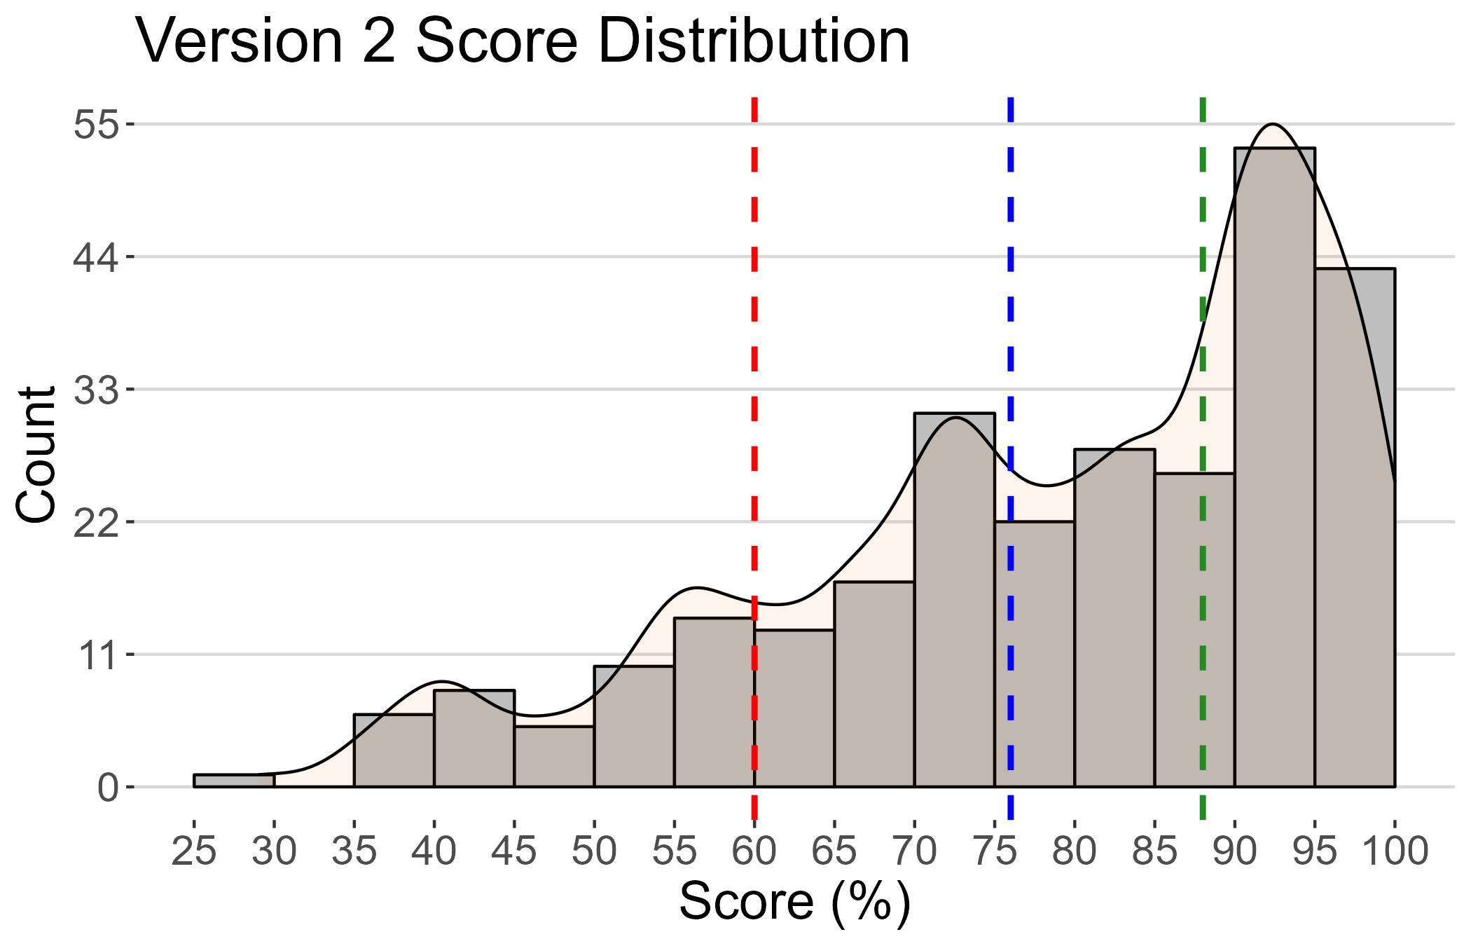
Version 2 Summary
version | Count | Mean (%) | Median (%) | Std. Dev (%) | Min (%) | Max (%) | # D/F's | # A's
Version 2 | 277 | 78.5 | 83.0 | 16.8 | 29.0 | 100.0 | 55 (20%) | 115 (42%)

Slide 10
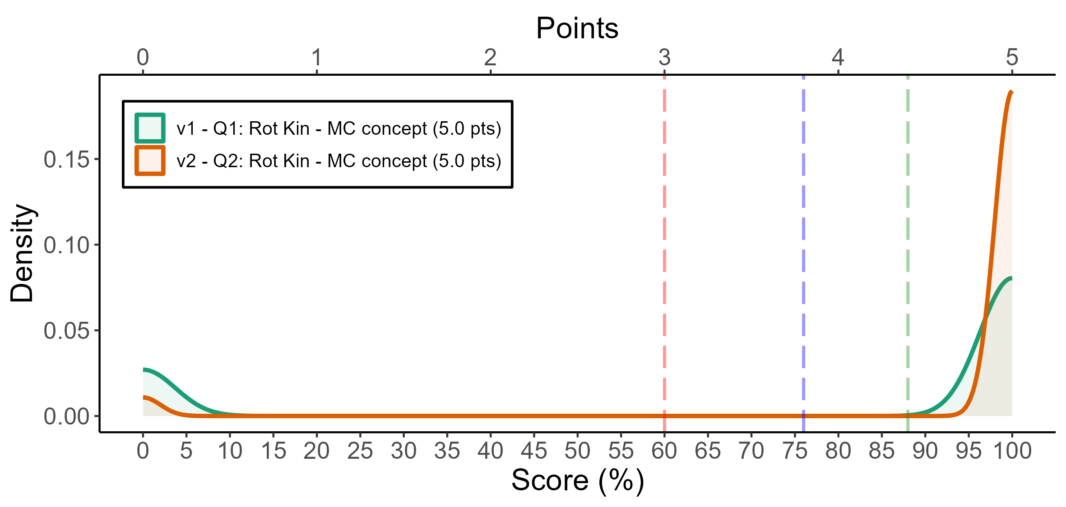
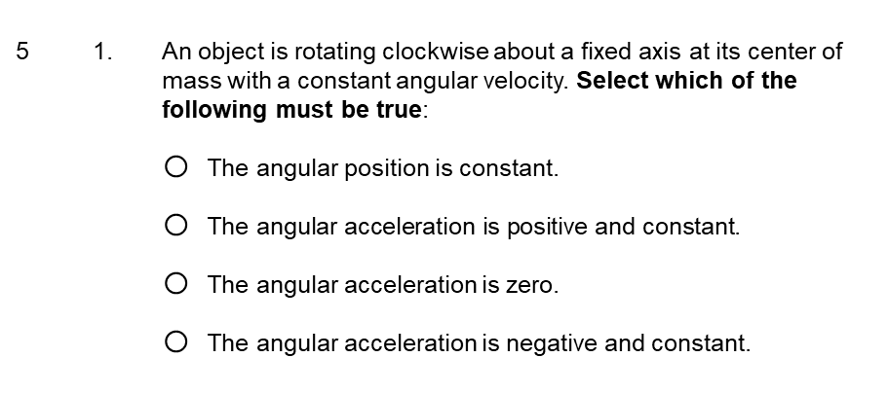
Rot. Kin. - MC Concept
5 1. An object is rotating clockwise about a fixed axis at its center of mass with a constant angular velocity. Select which of the following must be true:
The angular position is constant.
$\text{The} \text{angular} \text{acceleration} \text{is} \text{positive} \text{and} \text{constant}$.
The angular acceleration is zero.
The angular acceleration is negative and constant.
 | F | D | C- | C | C+ | B- | B | B+ | A- | A | A+
v1 | 80 | 0 | 0 | 0 | 0 | 0 | 0 | 0 | 0 | 0 | 238
v2 | 15 | 0 | 0 | 0 | 0 | 0 | 0 | 0 | 0 | 0 | 262
# | Pts | Cut | Applied (%)
V2 - Q2 | 0 | Correct (D) | 95
V1 - Q2 | 0 | Correct (Option D) | 81
V1 - Q1 | 0 | Correct (Option C) | 75
V2 - Q1 | 0 | Correct (A) | 74
V1 - Q1 | 5 | Incorrect (Option A | 25
version | Count | Mean | SD | # D/F's | # A's
v1 | 318 | 74.8 | 43.5 | 80 (25%) | 238 (75%)
v2 | 277 | 94.6 | 22.7 | 15 (5%) | 262 (95%)

Slide 11
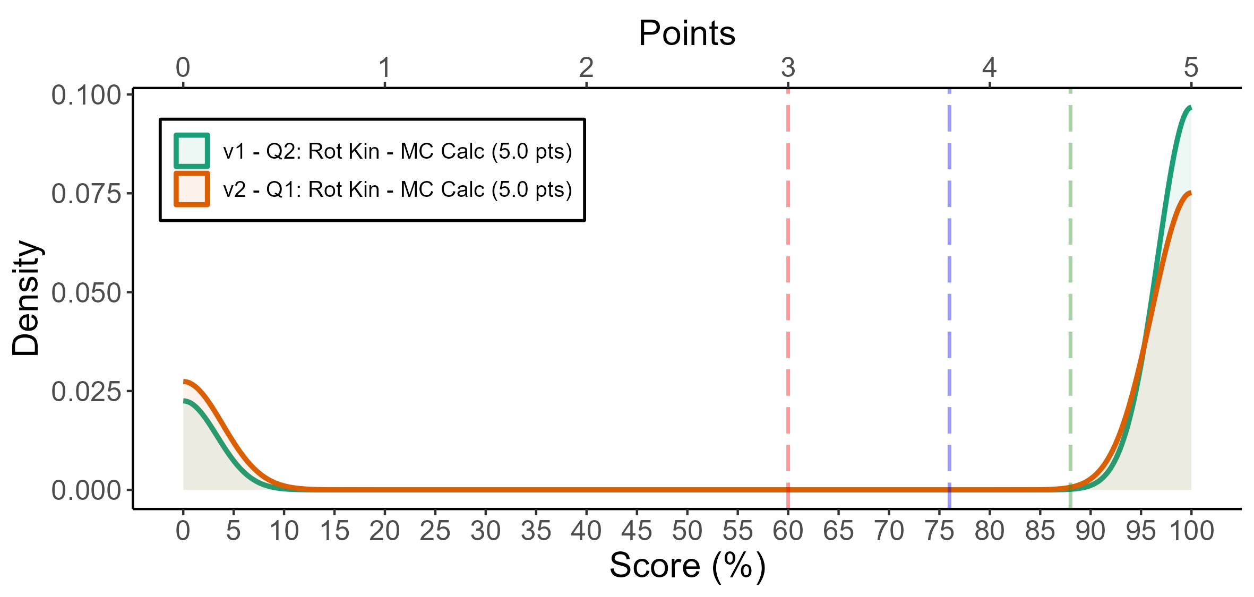
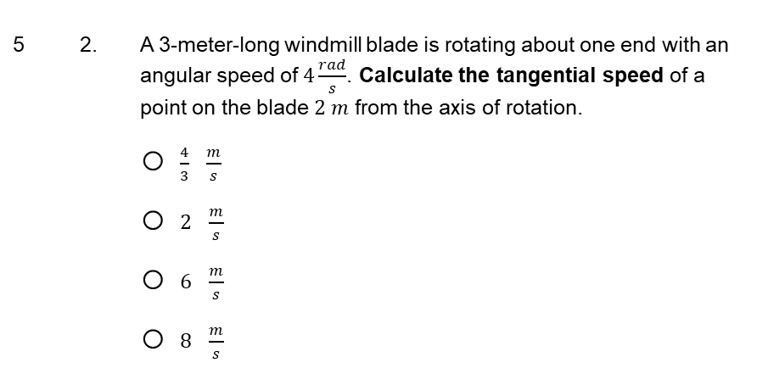
Rot. Kin. - MC Calc
5 2. A 3-meter-long windmill blade is rotating about one end with an angular speed of $4\frac{rad}{s}$. Calculate the tangential speed of a point on the blade $2 m$ from the axis of rotation.
$\frac{4}{3} \frac{m}{s}$
$2 \frac{m}{s}$
$6 \frac{m}{s}$
$8 \frac{m}{s}$
 | F | D | C- | C | C+ | B- | B | B+ | A- | A | A+
v1 | 60 | 0 | 0 | 0 | 0 | 0 | 0 | 0 | 0 | 0 | 258
v2 | 74 | 0 | 0 | 0 | 0 | 0 | 0 | 0 | 0 | 0 | 203
# | Pts | Cut | Applied (%)
V1 - Q2 | 0 | Correct (Option D) | 81
V2 - Q1 | 0 | Correct (A) | 74
version | Count | Mean | SD | # D/F's | # A's
v1 | 318 | 81.1 | 39.2 | 60 (19%) | 258 (81%)
v2 | 277 | 73.3 | 44.3 | 74 (27%) | 203 (73%)

Slide 12
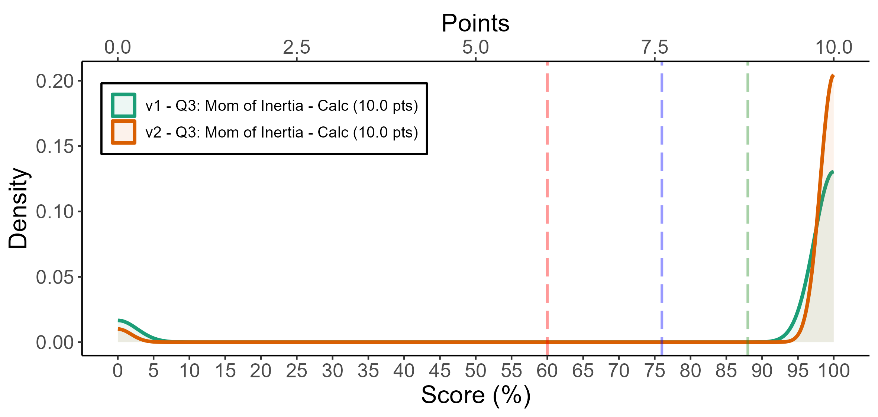

Moment of Inertia - MC Calc
10 3. A baseball can be approximated as a uniform solid sphere with a mass of $0.14 kg$ and a radius of$0.037 m$. Calculate the moment of inertia of the baseball about its center of mass.
$I_{com}=9.6×{10}^{−5} kg m^{2}$
$I_{com}=7.6×{10}^{−5} kg m^{2}$
$I_{com}=19 ×{10}^{−5} kg m^{2}$
$I_{com}=13 ×{10}^{−5} kg m^{2}$
$I_{com}=0.0021 kg m^{2}$
 | F | D | C- | C | C+ | B- | B | B+ | A- | A | A+
v1 | 36 | 0 | 0 | 0 | 0 | 0 | 0 | 0 | 0 | 0 | 282
v2 | 13 | 0 | 0 | 0 | 0 | 0 | 0 | 0 | 0 | 0 | 264
# | Pts | Cut | Applied (%)
V2 - Q3 | 0 | Correct (C) | 96
V1 - Q3 | 0 | Correct (Option B) | 89
version | Count | Mean | SD | # D/F's | # A's
v1 | 318 | 88.7 | 31.7 | 36 (11%) | 282 (89%)
v2 | 277 | 95.3 | 21.2 | 13 (5%) | 264 (95%)

Slide 13
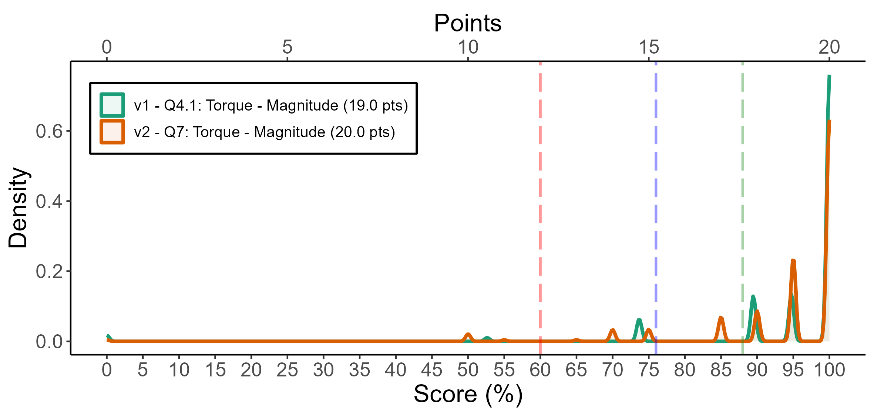

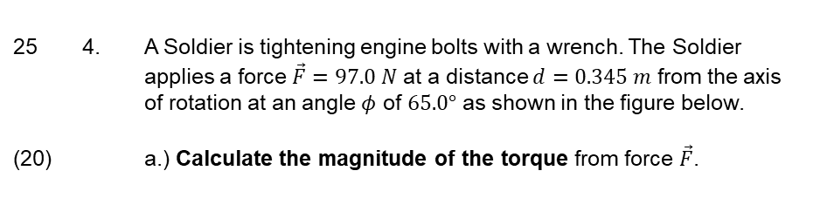


Torque - Magnitude
25 4. A Soldier is tightening engine bolts with a wrench. The Soldier applies a force $\vec{F}=97.0 N$ at a distance $d=0.345 m$ from the axis of rotation at an angle $φ$ of $65.0°$ as shown in the figure below.
(20) a.) Calculate the magnitude of the torque from force $\vec{F}$.
Axis of rotation
$$\vec{F}$$
$$φ$$
$$d$$
 | F | D | C- | C | C+ | B- | B | B+ | A- | A | A+
v1 | 8 | 0 | 0 | 0 | 18 | 0 | 0 | 0 | 36 | 37 | 219
v2 | 7 | 0 | 1 | 8 | 8 | 0 | 0 | 17 | 21 | 58 | 157
# | Pts | Cut | Applied (%)
V1 - Q4.1 | 0 | Correct Answer | 69
V2 - Q7 | 0 | Correct Answer | 57
V2 - Q7 | 1 | Incorrect units or SF | 33
V2 - Q7 | 2 | Incorrect Answer | 23
version | Count | Mean | SD | # D/F's | # A's
v1 | 318 | 94.7 | 14.3 | 8 (3%) | 292 (92%)
v2 | 277 | 94.1 | 11.4 | 7 (3%) | 236 (85%)

Slide 14
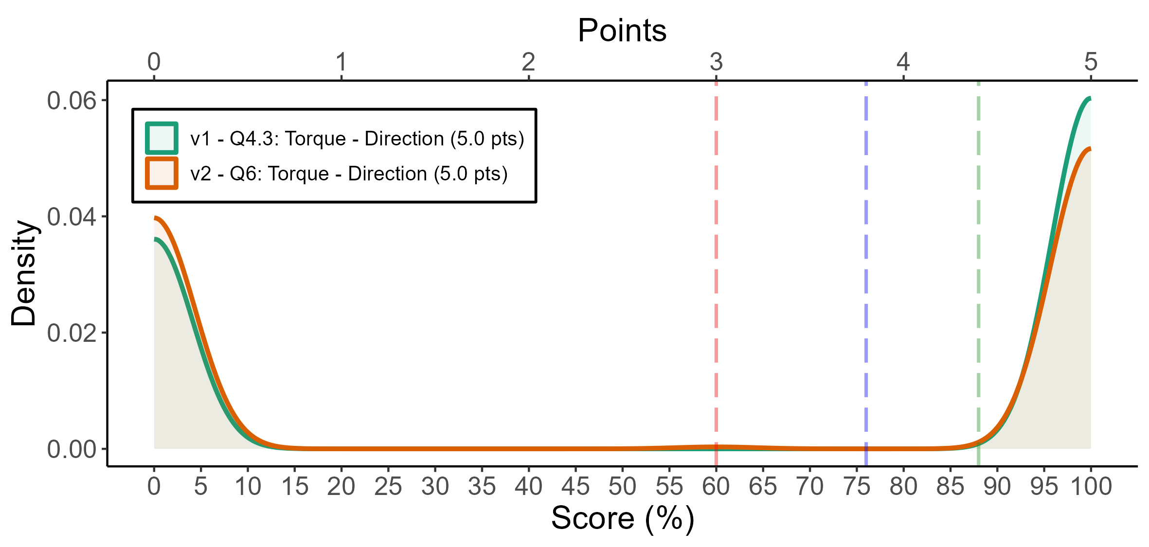
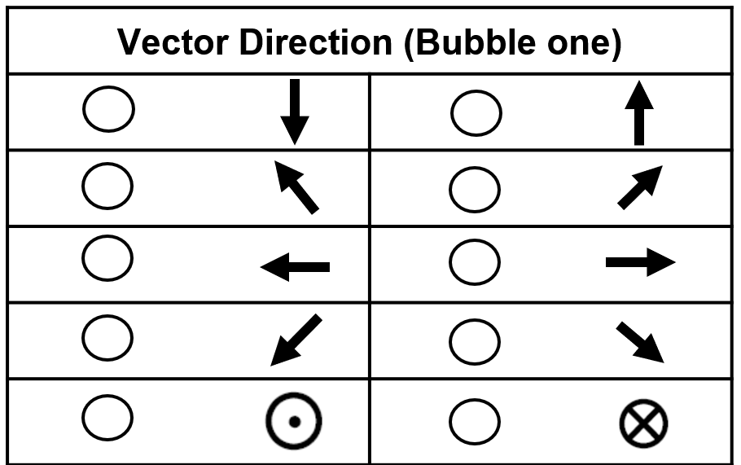
Torque - Direction
(5) b.) Determine the direction of the torque from force $\vec{F}$.
 | F | D | C- | C | C+ | B- | B | B+ | A- | A | A+
v1 | 119 | 0 | 0 | 0 | 0 | 0 | 0 | 0 | 0 | 0 | 199
v2 | 120 | 1 | 0 | 0 | 0 | 0 | 0 | 0 | 0 | 0 | 156
# | Pts | Cut | Applied (%)
V1 - Q4.3 | 0 | Correct Direction (out of page) | 63
V2 - Q6 | 0 | Correct Direction (out of page) | 57
V2 - Q6 | 5 | Incorrect direction (into page) | 44
version | Count | Mean | SD | # D/F's | # A's
v1 | 318 | 62.6 | 48.5 | 119 (37%) | 199 (63%)
v2 | 277 | 56.5 | 49.6 | 121 (44%) | 156 (56%)

Slide 15
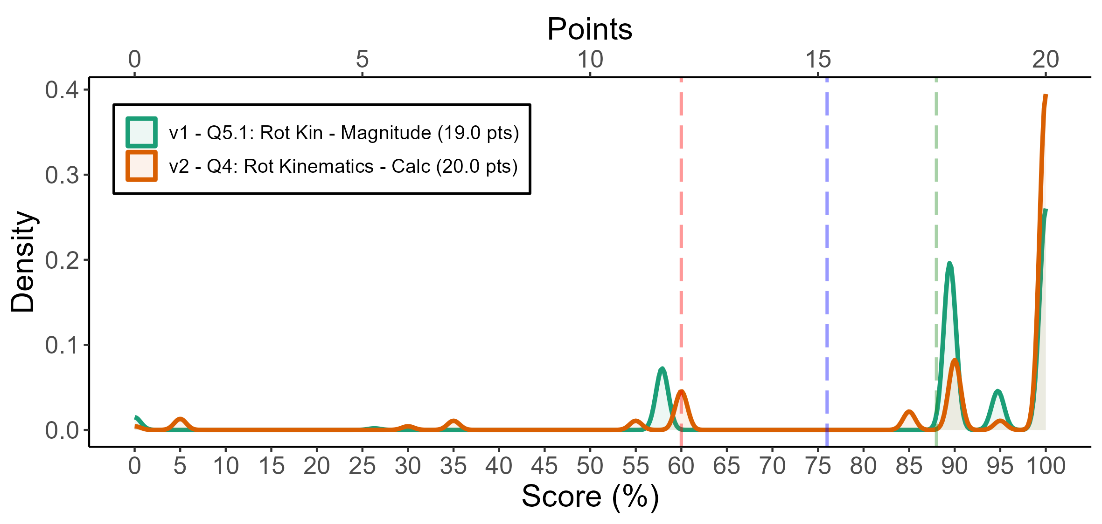
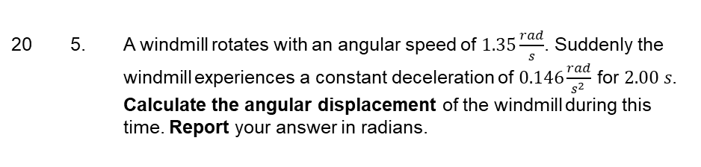
Rot. Kin. Med Calc
20 5. A windmill rotates with an angular speed of $1.35\frac{rad}{s}$. Suddenly the windmill experiences a constant deceleration of $0.146\frac{rad}{s^{2 }}$ for $2.00 s$.
Calculate the angular displacement of the windmill during this time. Report your answer in radians.
 | F | D | C- | C | C+ | B- | B | B+ | A- | A | A+
v1 | 48 | 0 | 0 | 0 | 0 | 0 | 0 | 0 | 106 | 25 | 139
v2 | 20 | 21 | 0 | 0 | 0 | 0 | 0 | 10 | 38 | 5 | 183
# | Pts | Cut | Applied (%)
V2 - Q4 | 0 | Correct Answer | 66
V1 - Q5.1 | 2 | Incorrect ANS | 49
V1 - Q5.1 | 0 | Correct Answer | 44
V2 - Q4 | 2 | Incorrect ANS | 32
version | Count | Mean | SD | # D/F's | # A's
v1 | 318 | 88.2 | 19.7 | 48 (15%) | 270 (85%)
v2 | 277 | 89.7 | 21.3 | 41 (15%) | 226 (82%)

Slide 16
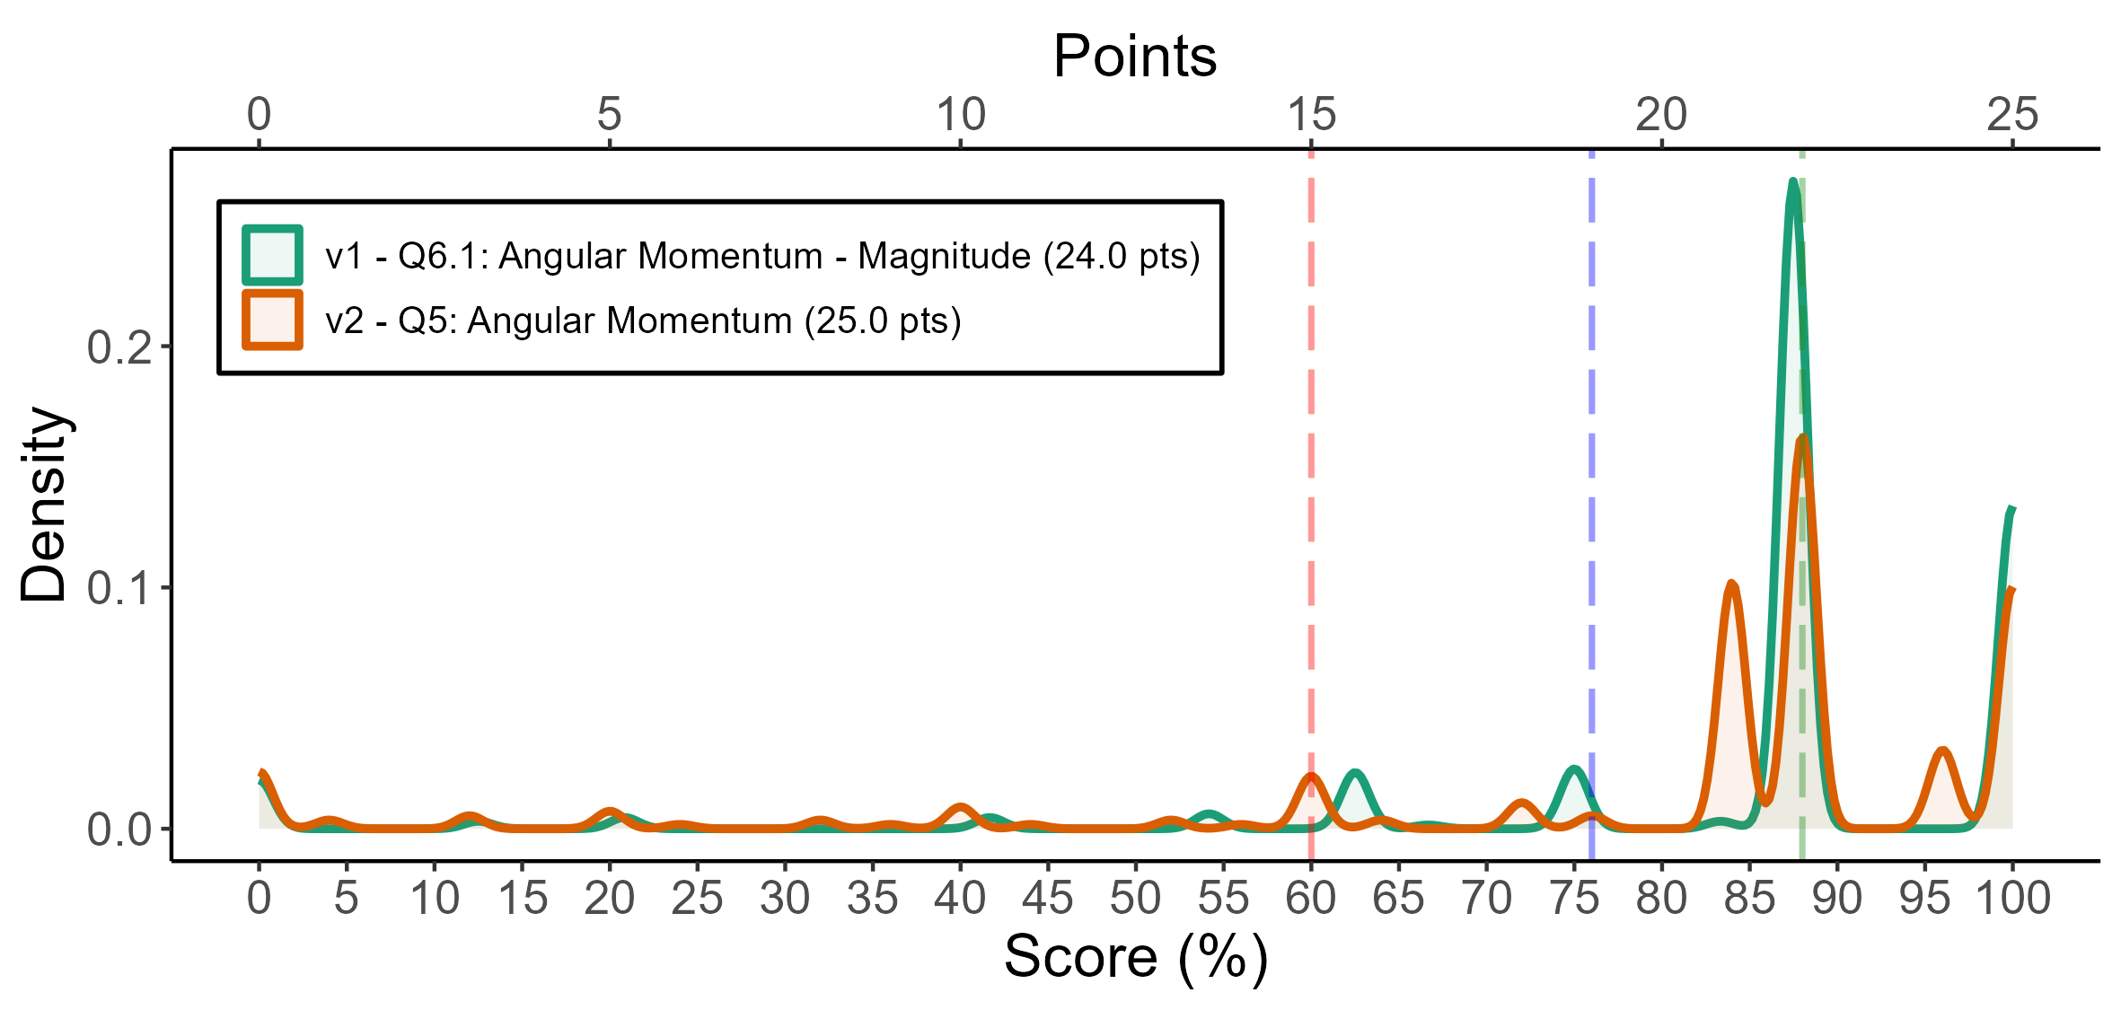
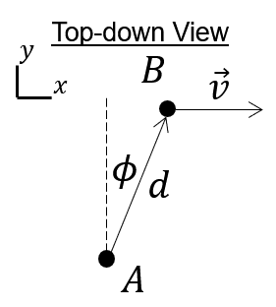
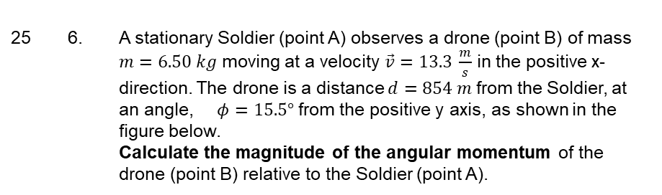
Ang. Mom. Point Particle
25 6. A stationary Soldier (point A) observes a drone (point B) of mass $m=6.50 kg$ moving at a velocity $\vec{v}=13.3 \frac{m}{s}$ in the positive x-direction. The drone is a distance $d=854 m$ from the Soldier, at an angle, $φ=15.5°$ from the positive y axis, as shown in the figure below.
Calculate the magnitude of the angular momentum of the drone (point B) relative to the Soldier (point A).
 | F | D | C- | C | C+ | B- | B | B+ | A- | A | A+
v1 | 25 | 15 | 1 | 0 | 16 | 0 | 2 | 173 | 0 | 0 | 86
v2 | 35 | 12 | 2 | 0 | 6 | 3 | 0 | 56 | 90 | 0 | 73
# | Pts | Cut | Applied (%)
V2 - Q5 | 3 | Incorrect Answer | 74
V1 - Q6.1 | 3 | Incorrect ANS | 73
V1 - Q6.2 | 0 | Correct Units ($$\frac{kg m}{s^2}$$) | 52
V1 - Q6.2 | 1 | Incorrect Units | 48
V2 - Q5 | 1 | Incorrect units or SF | 45
V1 - Q6.1 | 0 | Correct Answer | 27
version | Count | Mean | SD | # D/F's | # A's
v1 | 318 | 83.5 | 22.1 | 40 (13%) | 86 (27%)
v2 | 277 | 79.5 | 25.8 | 47 (17%) | 163 (59%)

Slide 17
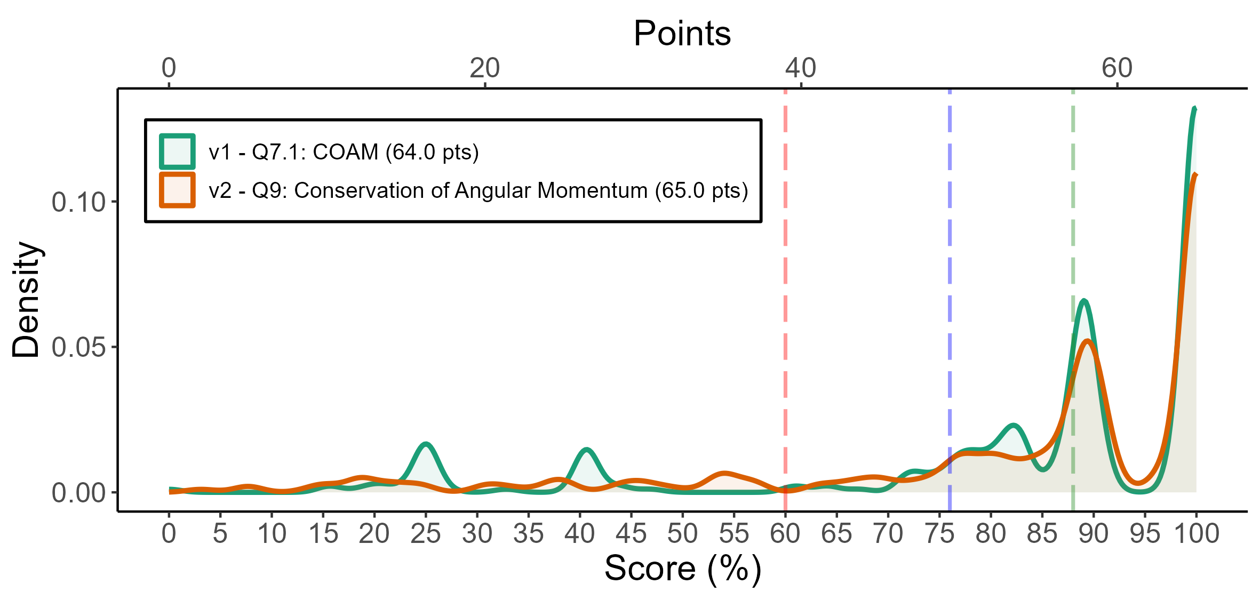
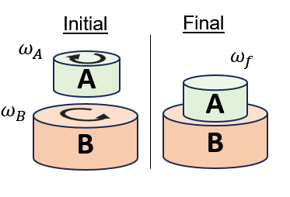

COAM
65 7. In a HMMWV’s transmission, gear A is a solid disk (mass $M_{A}=14.0 kg$, radius $R_{A}=0.120 m$) which spins clockwise (viewed from above) with an angular speed $ω_{A}=352\frac{rad}{s}.$ Gear B is a solid disk (mass$M_{B}=75.0 kg$, radius $R_{B}=0.250 m$) which spins counter-clockwise (viewed from above) with an angular speed $ω_{B}=1.50\frac{rad}{s}$. When the transmission engages gear A connects with gear B as shown, and they both rotate without slipping at the same angular speed. Calculate the magnitude of the angular velocity of the connected gears, $ω_{f}$.
 | F | D | C- | C | C+ | B- | B | B+ | A- | A | A+
v1 | 42 | 2 | 3 | 5 | 6 | 21 | 26 | 14 | 65 | 0 | 134
v2 | 42 | 2 | 5 | 4 | 7 | 12 | 16 | 21 | 53 | 1 | 114
# | Pts | Cut | Applied (%)
V2 - Q5 | 3 | Incorrect Answer | 74
V2 - Q9 | 6 | Answer: Incorrect Answer | 57
V1 - Q7.1 | 6 | Answer: Incorrect Answer | 49
V2 - Q5 | 1 | Incorrect units or SF | 45
V2 - Q9 | 0 | Correct Answer | 39
V1 - Q7.1 | 0 | Correct Answer | 38
V2 - Q9 | 1 | Key Terms - Final State: Combined Objects: Incorrect | 30
V2 - Q9 | 1 | Key Terms - Initial State: Initial B: Incorrect sign | 29
V1 - Q7.1 | 1 | Key Terms - Initial State: Initial B: Incorrect sign | 26
V2 - Q9 | 2 | Answer: Incorrect Units or SF | 22
V1 - Q7.1 | 5 | Applications: Incorrect moment of inertia applied | 21
version | Count | Mean | SD | # D/F's | # A's
v1 | 318 | 83.6 | 22.8 | 44 (14%) | 199 (63%)
v2 | 277 | 83.0 | 23.1 | 44 (16%) | 168 (61%)

Slide 18
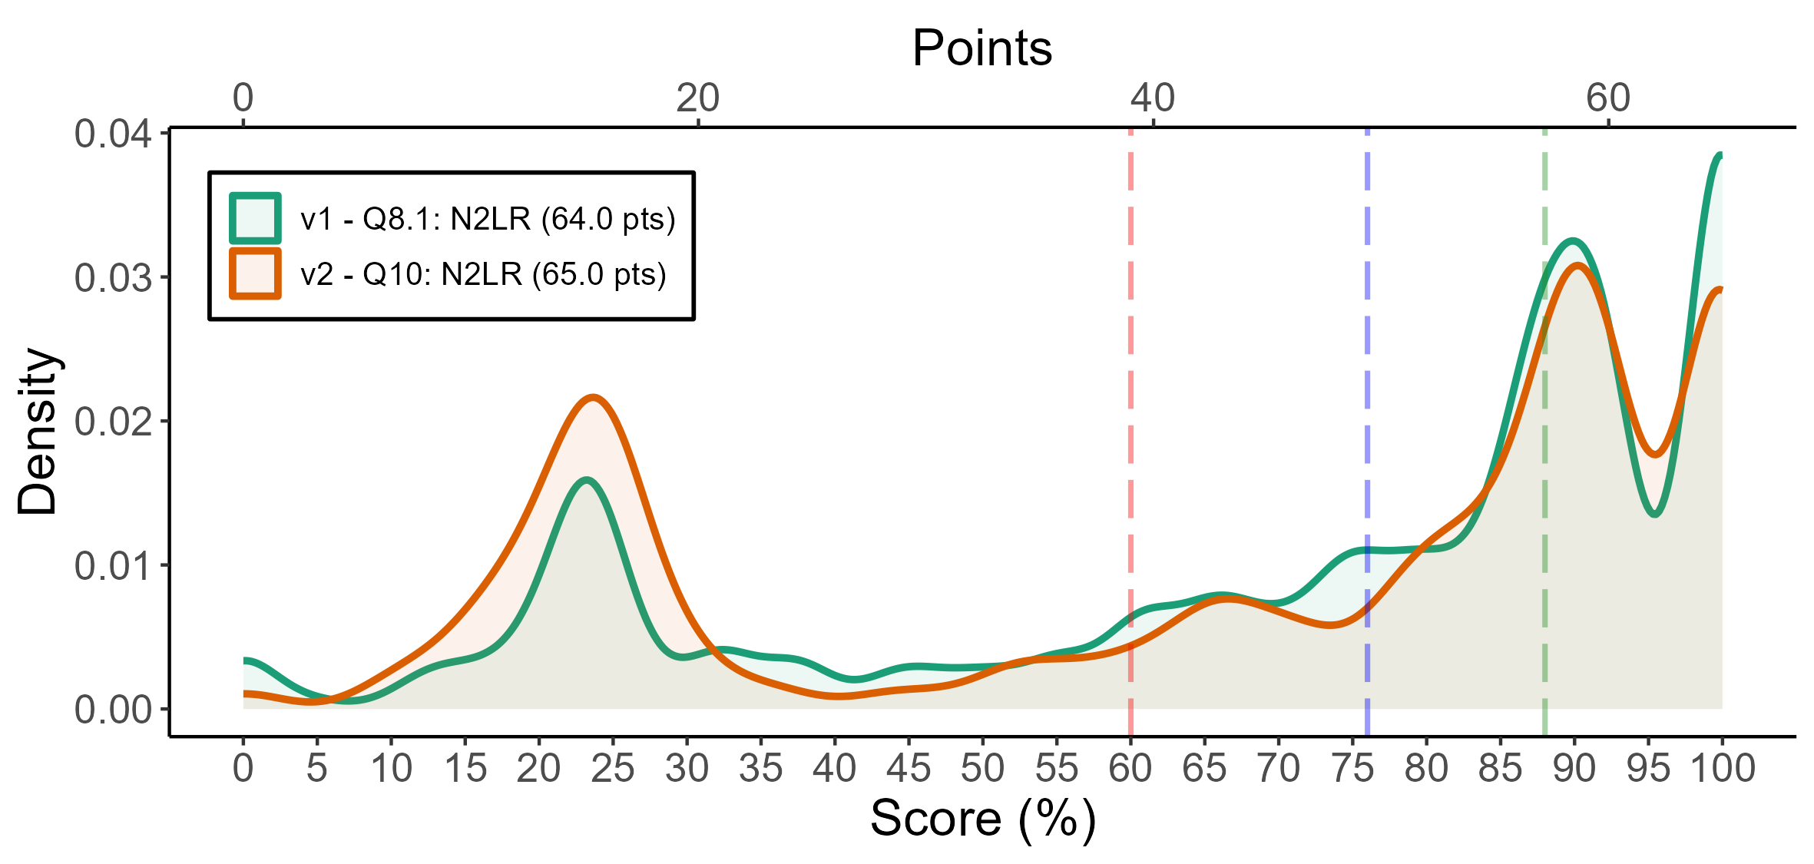
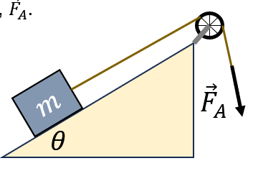
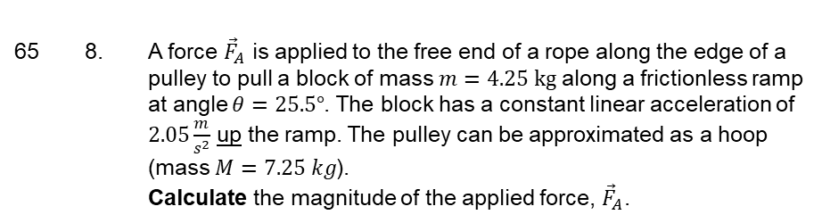
N2LR
65 8. A force ${\vec{F}}_{A}$ is applied to the free end of a rope along the edge of a pulley to pull a block of mass $m=4.25 kg$ along a frictionless ramp at angle $θ=25.5°$. The block has a constant linear acceleration of $2.05\frac{m}{s^{2}}$ up the ramp. The pulley can be approximated as a hoop (mass $M=7.25 kg$).
Calculate the magnitude of the applied force, ${\vec{F}}_{A}$.
 | F | D | C- | C | C+ | B- | B | B+ | A- | A | A+
v1 | 84 | 8 | 13 | 9 | 15 | 15 | 9 | 35 | 29 | 30 | 71
v2 | 90 | 6 | 11 | 5 | 6 | 9 | 16 | 19 | 33 | 26 | 56
# | Pts | Cut | Applied (%)
V2 - Q10 | 5 | Answer: Incorrect answer | 72
V1 - Q8.1 | 5 | Answer: Incorrect Answer | 68
V2 - Q10 | 1 | Key Terms : Applied Force ($$R F_A$$) incorrect sign | 43
V2 - Q10 | 1 | Key Terms : Tension ($$R T$$) incorrect sign | 40
V2 - Q10 | 2 | Key Terms : Tension ($$R T$$) Incorrect | 39
V1 - Q8.1 | 2 | Key Terms : Tension ($$R T$$) Incorrect | 36
V2 - Q10 | 2 | Key Terms Applied Force ($$R F_A$$) Incorrect | 36
V1 - Q8.1 | 1 | Key Terms Tension ($$R T$$) incorrect sign (- is correct) | 35
V1 - Q8.1 | 2 | Key : Applied Force ($$R F_A$$) Incorrect | 35
V2 - Q10 | 5 | Applications: Does not apply link equation | 33
V2 - Q10 | 3 | Applications: Does not substitute from N2L into N2L-R | 32
V2 - Q10 | 3 | Physics: No acceleration link equation ($$\alpha = \frac{a}{r}$$) | 30
V1 - Q8.1 | 1 | Key Terms : Applied Force ($$R F_A$$) Incorrect sign (+ is correct) | 29
V1 - Q8.1 | 5 | Applications: Does not apply link equation | 26
V1 - Q8.1 | 3 | Applications: Incorrect moment of inertia applied | 26
V1 - Q8.1 | 3 | Applications: Does not substitute from N2L into N2L-R | 25
V2 - Q10 | 7 | Physics: No torque ($$\tau = \vec{r} \times \vec{F}$$) | 24
V2 - Q10 | 1 | Answer: Incorrect SF | 22
V1 - Q8.1 | 0 | Correct Answer | 21
V2 - Q10 | 17 | Physics: No N2L-Rotation ($$\Sigma \tau = I \alpha$$) | 21
version | Count | Mean | SD | # D/F's | # A's
v1 | 318 | 72.1 | 28.9 | 92 (29%) | 130 (41%)
v2 | 277 | 67.9 | 31.3 | 96 (35%) | 115 (42%)

Slide 19
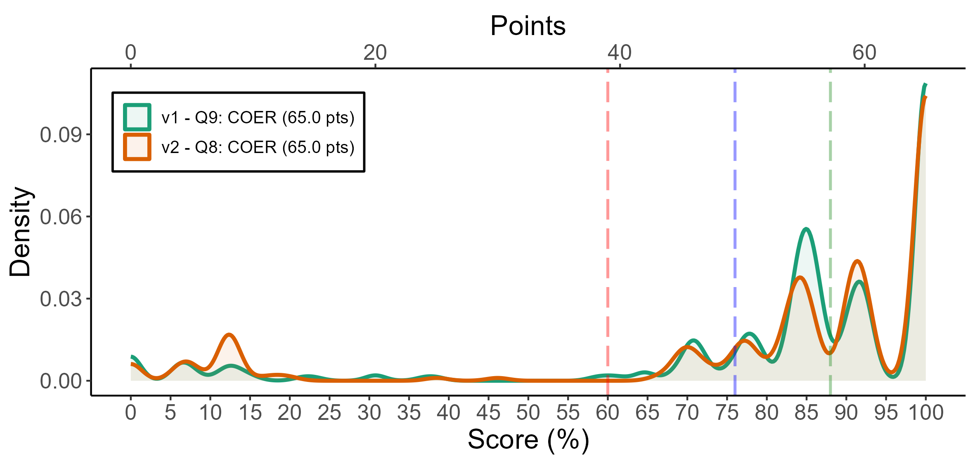
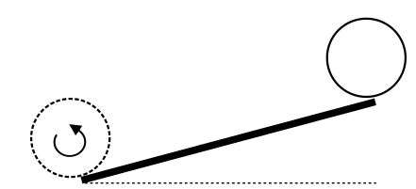

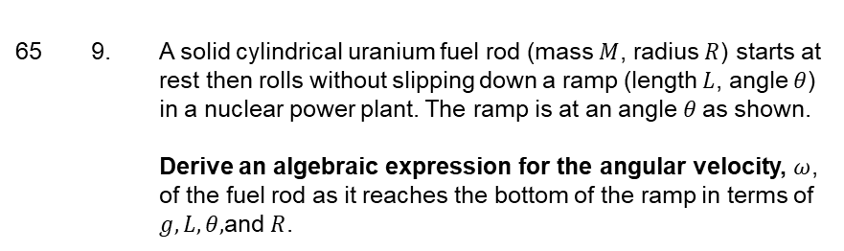

COER
65 9. A solid cylindrical uranium fuel rod (mass $M$, radius $R$) starts at rest then rolls without slipping down a ramp (length $L$, angle $θ$) in a nuclear power plant. The ramp is at an angle $θ$as shown.
Derive an algebraic expression for the angular velocity, $ω$, of the fuel rod as it reaches the bottom of the ramp in terms of $g,L,θ,$and $R$.
$$L$$
$$θ$$
 | F | D | C- | C | C+ | B- | B | B+ | A- | A | A+
v1 | 32 | 2 | 4 | 15 | 6 | 20 | 16 | 64 | 23 | 25 | 111
v2 | 36 | 0 | 2 | 13 | 6 | 15 | 21 | 30 | 29 | 22 | 103
# | Pts | Cut | Applied (%)
V1 - Q9 | 5 | Answer: Incorrect Answer | 58
V2 - Q8 | 5 | Answer: Incorrect answer | 57
V2 - Q8 | 0 | Correct answer | 37
V1 - Q9 | 0 | Correct Answer | 35
V2 - Q8 | 5 | Application: Does not apply link eqn | 34
V1 - Q9 | 5 | Application: Does not apply link equation | 32
V2 - Q8 | 1 | COE Key Terms: $$U_g$$: $$U_g$$ incorrect | 32
V1 - Q9 | 4 | Application: Does not apply correct moment of inertia | 23
V1 - Q9 | 1 | COE Key Terms: $$U_g$$: $$U_g$$ incorrect | 20
version | Count | Mean | SD | # D/F's | # A's
v1 | 318 | 82.1 | 25.5 | 34 (11%) | 159 (50%)
v2 | 277 | 80.5 | 28.5 | 36 (13%) | 154 (56%)

Slide 20
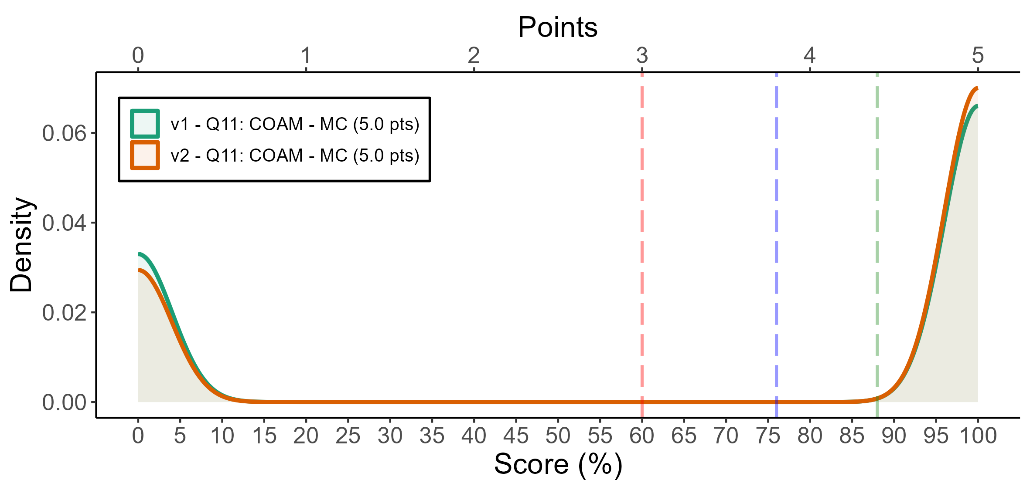

COAM - MC
5 11. A merry go round is initially spinning at a constant angular velocity $ω_{0}$ with four children in the center. Two of the children move to the edge of the merry go round. Select the most correct statement regarding the angular velocity $ω_{F}$ of the merry go round after the children move assuming no net external torque is applied to the merry go round :
$ω_{0}>ω_{F}$
$ω_{0}=ω_{F}$
$ω_{0}<ω_{F}$
 | F | D | C- | C | C+ | B- | B | B+ | A- | A | A+
v1 | 106 | 0 | 0 | 0 | 0 | 0 | 0 | 0 | 0 | 0 | 212
v2 | 82 | 0 | 0 | 0 | 0 | 0 | 0 | 0 | 0 | 0 | 195
# | Pts | Cut | Applied (%)
V2 - Q11 | 0 | Correct answer (C) | 71
V1 - Q11 | 0 | Correct (Option A) | 67
V1 - Q7.1 | 6 | Answer: Incorrect Answer | 49
V1 - Q7.1 | 0 | Correct Answer | 38
V1 - Q11 | 5 | Incorrect (Option C) | 28
V1 - Q7.1 | 1 | Key Terms - Initial State: Initial B: Incorrect sign | 26
V1 - Q7.1 | 5 | Applications: Incorrect moment of inertia applied | 21
V2 - Q11 | 5 | Incorrect (A) | 21
version | Count | Mean | SD | # D/F's | # A's
v1 | 318 | 66.7 | 47.2 | 106 (33%) | 212 (67%)
v2 | 277 | 70.4 | 45.7 | 82 (30%) | 195 (70%)

Slide 21
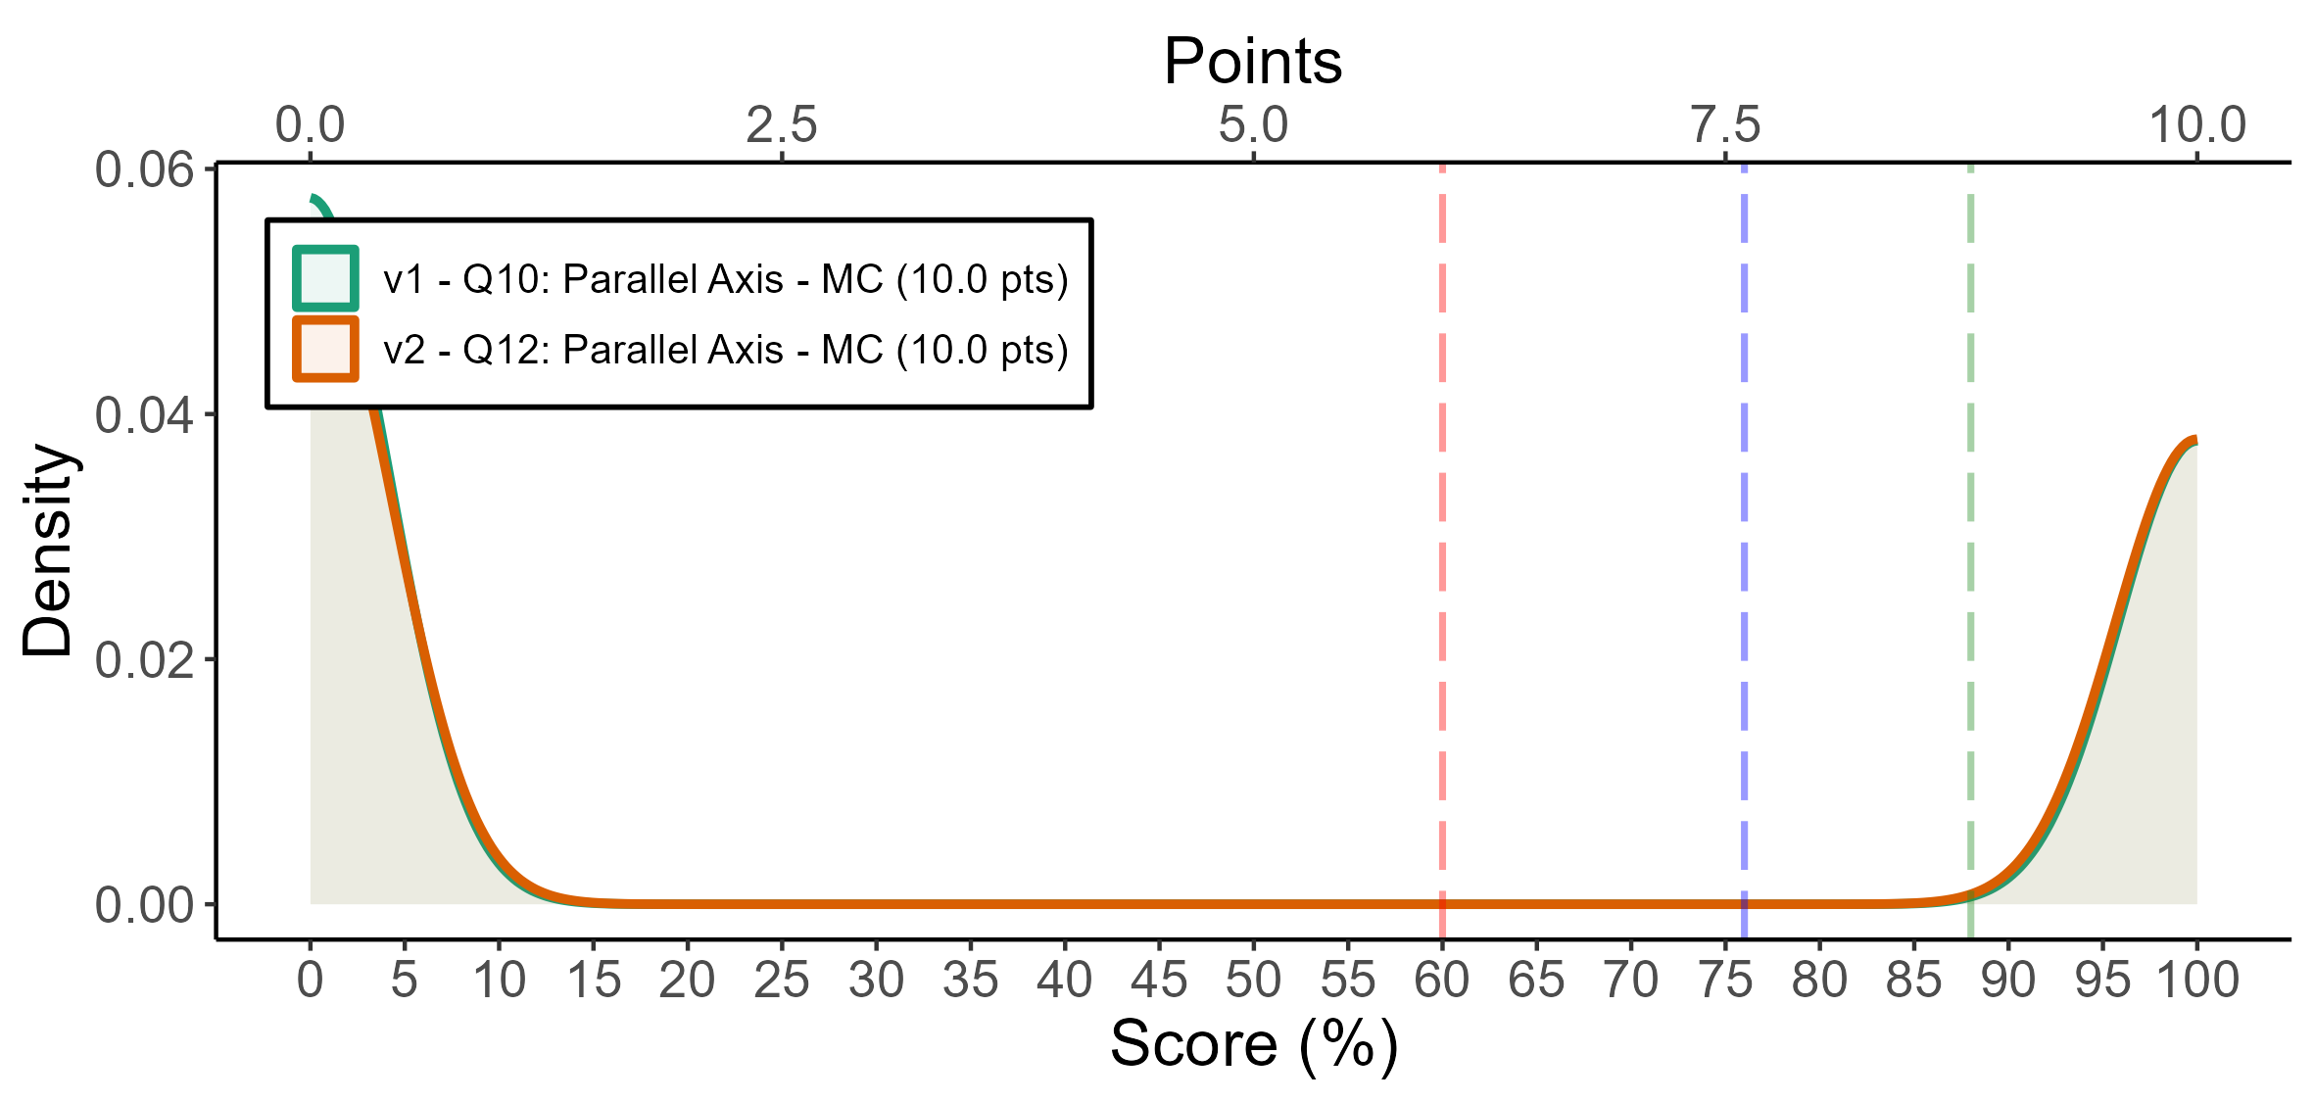
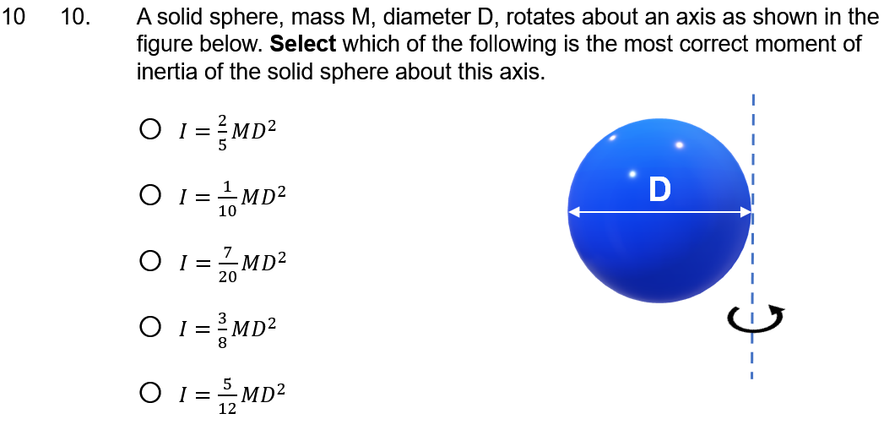
Parallel Axis Thm - MC
 | F | D | C- | C | C+ | B- | B | B+ | A- | A | A+
v1 | 192 | 0 | 0 | 0 | 0 | 0 | 0 | 0 | 0 | 0 | 126
v2 | 163 | 0 | 0 | 0 | 0 | 0 | 0 | 0 | 0 | 0 | 114
# | Pts | Cut | Applied (%)
V2 - Q12 | 0 | Correct (D) | 41
V1 - Q10 | 0 | Correct (Option C) | 40
V1 - Q10 | 10 | Incorrect (Option A) | 24
V1 - Q10 | 10 | Incorrect (Option B) | 22
V2 - Q12 | 10 | Incorrect E | 21
version | Count | Mean | SD | # D/F's | # A's
v1 | 318 | 39.6 | 49.0 | 192 (60%) | 126 (40%)
v2 | 277 | 41.2 | 49.3 | 163 (59%) | 114 (41%)

Slide 22
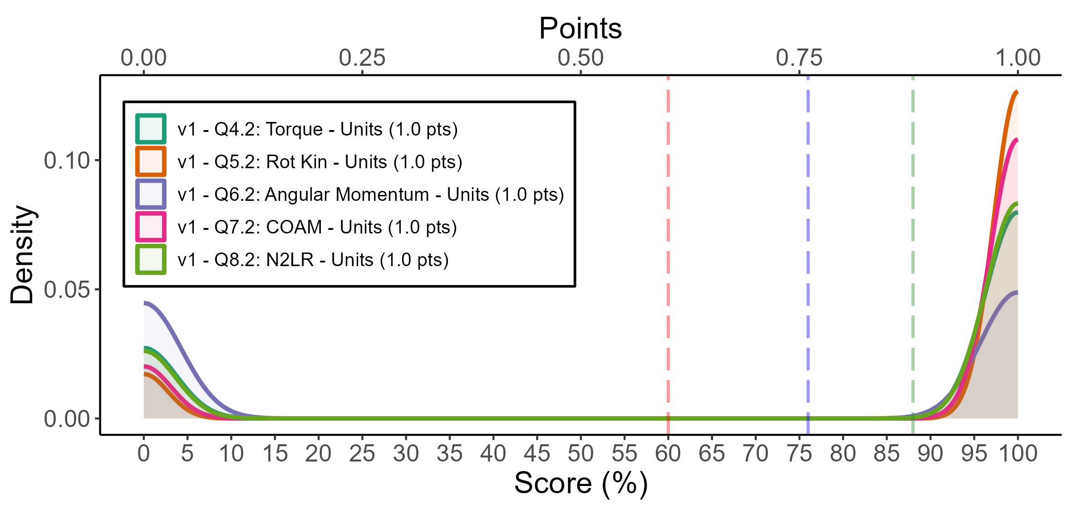
Units
 | F | D | C- | C | C+ | B- | B | B+ | A- | A | A+
v1 | 397 | 0 | 0 | 0 | 0 | 0 | 0 | 0 | 0 | 0 | 1,193
# | Pts | Cut | Applied (%)
V1 - Q5.2 | 0 | Correct units (rad) | 88
V1 - Q7.2 | 0 | Correct Units (kgm/s^2) | 85
V1 - Q8.2 | 0 | Correct (N) | 76
V1 - Q4.2 | 0 | Correct Units (Nm) | 75
version | Count | Mean | SD | # D/F's | # A's
v1 | 1,590 | 75.0 | 43.3 | 397 (25%) | 1193 (75%)

Slide 23
WPR2 Grading Timeline
0740
Day 1
Day 2
Day 3
1610|0740
1610|0740
Administered exams
0915 Began scanning 0945 most scans uploaded and processed
~10 minutes from scanner to Gradescope complete
0930
Almost Caught up, new batch uploaded
1615
All scans uploaded
Done for day
1600
All scans uploaded
Done for day
1015
Grading complete
1430
Caught up with administered exams

Slide 24
Gradescope Takeaways
Scanning was easier than expected and was fast
More efficient and less mentally taxing
Both in grading and data management
easier to grade with rubric on your screen, adding for you
Cut data can help us identify learning objectives with much better resolution to improve next semesters
Feedback could be very specific
Next time (TEE):
Computer lab for grading on better monitors
Improved Gradescope rubric going into the exam

Slide 25
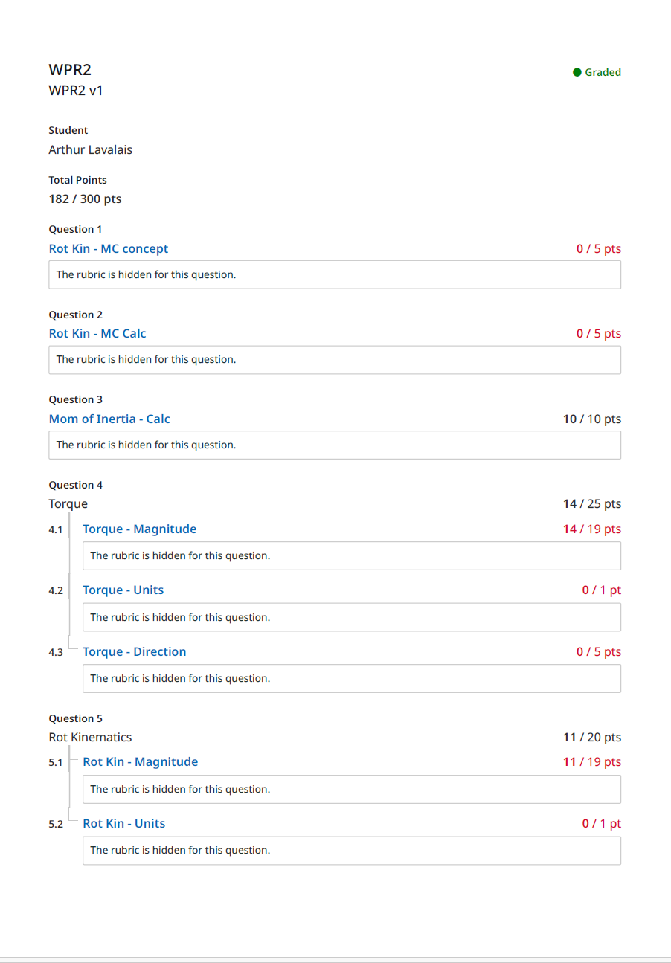
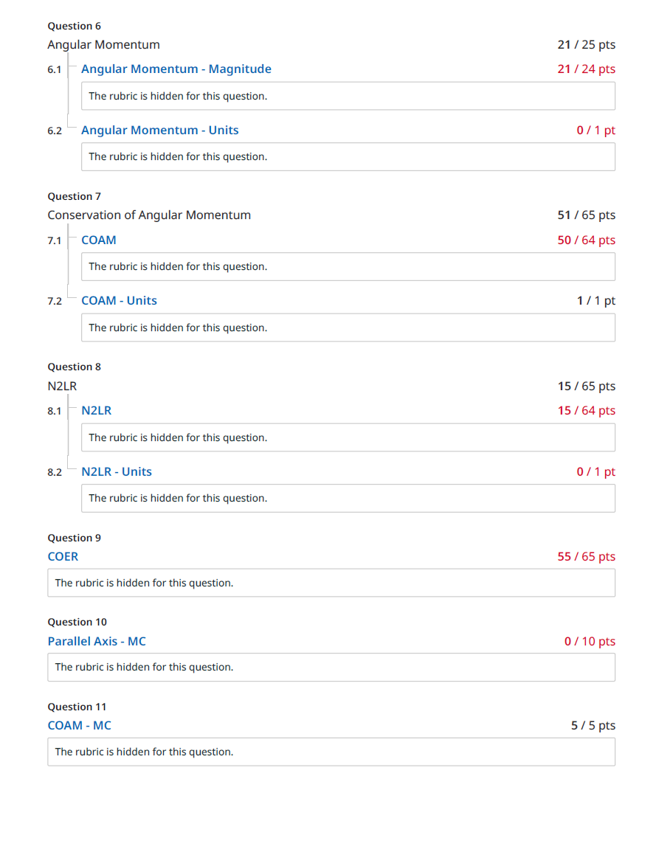
Example pdf to Cadet (Cover page summary + scanned copy of exam)

Slide 26
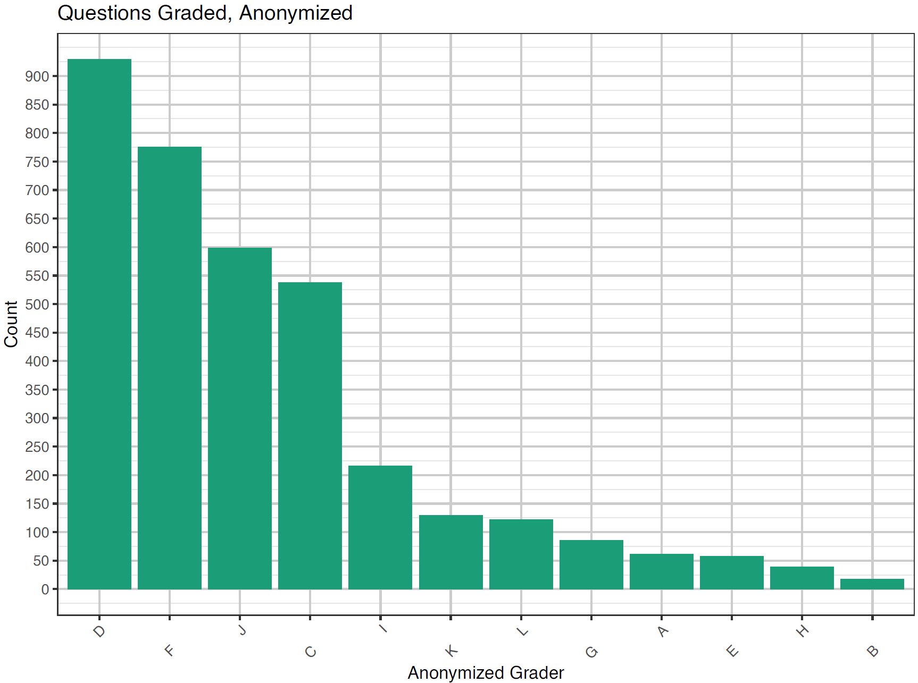
Grade actions by instructors
Of our instructors ~4 were unable to assist in a heavy grading load
This isn’t to call out personnel manning
This is to help quantify that we achieved this grading speed with significant (~33%) manning shortfalls
Questions graded summed by anonymized instructor for medium and long calculation problems. Multiple choice problems were omitted as they are extremely fast to grade and skew the data. The bottom five instructors graded
Notes:
595 Cadets x 6 Med/Long Problems: 3570
Expected grading per instructor: 3570/12=300
Bottom 5 grade actions: 262
Top Grading actions: 929
ShortCalc grading: ~595 per problem (can go fast, but not always)

